Slide 1
Transport Layer CS 3516 – Computer Networks

Slide 2
Chapter 3: Transport Layer
Goals:
Understand principles behind transport layer services:
Multiplexing / demultiplexing
Reliable data transfer
Flow control
Congestion control
Learn about transport layer protocols in the Internet:
UDP: connectionless transport
TCP: connection-oriented transport
TCP congestion control

Slide 3
Chapter 3 outline
3.5 Connection-oriented transport: TCP
segment structure
reliable data transfer
flow control
connection management
3.6 Principles of congestion control
3.7 TCP congestion control
3.1 Transport-layer services
3.2 Multiplexing and demultiplexing
3.3 Connectionless transport: UDP
3.4 Principles of reliable data transfer

Slide 4

Transport Services and Protocols
application
transport
network
data link
physical
Provide logical communication between app processes running on different hosts
Transport protocols run in end systems
send side: breaks app messages into segments, passes to network layer
receive side: reassembles segments into messages, passes to app layer
More than one transport protocol available to apps
Internet: TCP and UDP
logical end-end transport
application
transport
network
data link
physical

Slide 5
Transport vs. Network layer
Household analogy:
12 kids sending letters to 12 kids
processes = kids
app messages = letters in envelopes
hosts = houses
transport protocol = Ann and Bill (collect mail from siblings)
network-layer protocol = postal service
network layer: logical communication between hosts
transport layer: logical communication between processes
relies on, enhances, network layer services

Slide 6
Internet Transport-layer Protocols
reliable, in-order delivery (TCP)
congestion control
flow control
connection setup
unreliable, unordered delivery: UDP
no-frills extension of “best-effort” IP
services not available:
delay guarantees
bandwidth guarantees
application
transport
network
data link
physical
network
data link
physical
network
data link
physical
logical end-end transport
network
data link
physical
network
data link
physical
network
data link
physical
network
data link
physical
application
transport
network
data link
physical

Slide 7
Chapter 3 outline
3.5 Connection-oriented transport: TCP
segment structure
reliable data transfer
flow control
connection management
3.6 Principles of congestion control
3.7 TCP congestion control
3.1 Transport-layer services
3.2 Multiplexing and demultiplexing
3.3 Connectionless transport: UDP
3.4 Principles of reliable data transfer

Slide 8
Chapter 3 outline
3.5 Connection-oriented transport: TCP
segment structure
reliable data transfer
flow control
connection management
3.6 Principles of congestion control
3.7 TCP congestion control
3.1 Transport-layer services
3.2 Multiplexing and demultiplexing
3.3 Connectionless transport: UDP
3.4 Principles of reliable data transfer

Slide 9
UDP: User Datagram Protocol [RFC 768]
“no frills,” “bare bones” Internet transport protocol
“best effort” service, UDP segments may be:
lost
delivered out of order to app
connectionless:
no handshaking between UDP sender, receiver
each UDP segment handled independently of others
Why is there a UDP?
Finer application control over data
No connection establishment
No connection state
Smaller packet overhead

Slide 10
UDP: more
Often used for streaming (video/audio) or game apps
loss tolerant
rate sensitive
other UDP uses
DNS
SNMP
reliable transfer over UDP: add reliability at application layer
application-specific error recovery!
32 bits
Length, in
bytes of UDP
segment,
including
header
source port #
dest port #
length
checksum
Application
data
(message)
UDP segment format

Slide 11
UDP: checksum
Goal: detect “errors” (e.g., flipped bits) in transmitted segment
Sender:
treat segment contents as sequence of 16-bit integers
checksum: addition (1’s complement sum) of segment contents
sender puts checksum value into UDP checksum field
Receiver:
compute checksum of received segment
check if computed checksum equals checksum field value:
NO - error detected
YES - no error detected. But maybe errors nonetheless? More later ….

Slide 12
Internet Checksum Example
Example: add two 16-bit integers
1 1 1 1 0 0 1 1 0 0 1 1 0 0 1 1 0
1 1 1 0 1 0 1 0 1 0 1 0 1 0 1 0 1
1 1 0 1 1 1 0 1 1 1 0 1 1 1 0 1 1
1 1 0 1 1 1 0 1 1 1 0 1 1 1 1 0 0
1 0 1 0 0 0 1 0 0 0 1 0 0 0 0 1 1
wraparound
sum
checksum
At receiver, add 2 integers and checksum … should be all 1’s. If not, bit error (correction? → next)
Notes:
Kurose and Ross forgot to say anything about wrapping the carry and adding it to low order bit

Slide 13
Chapter 3 outline
3.5 Connection-oriented transport: TCP
segment structure
reliable data transfer
flow control
connection management
3.6 Principles of congestion control
3.7 TCP congestion control
3.1 Transport-layer services
3.2 Multiplexing and demultiplexing
3.3 Connectionless transport: UDP
3.4 Principles of reliable data transfer

Slide 14
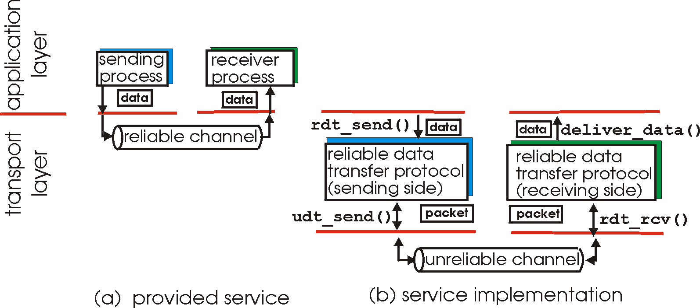
Principles of Reliable data transfer
important in app., transport, link layers
top-10 list of important networking topics!
characteristics of unreliable channel will determine complexity of reliable data transfer protocol (rdt)

Slide 15
Principles of Reliable data transfer
important in app., transport, link layers
top-10 list of important networking topics!
characteristics of unreliable channel will determine complexity of reliable data transfer protocol (rdt)

Slide 16
Principles of Reliable Data Transfer
important in app., transport, link layers
top-10 list of important networking topics!
(Zoom next slide)
Characteristics of unreliable channel will determine complexity of reliable data transfer protocol (rdt)

Slide 17
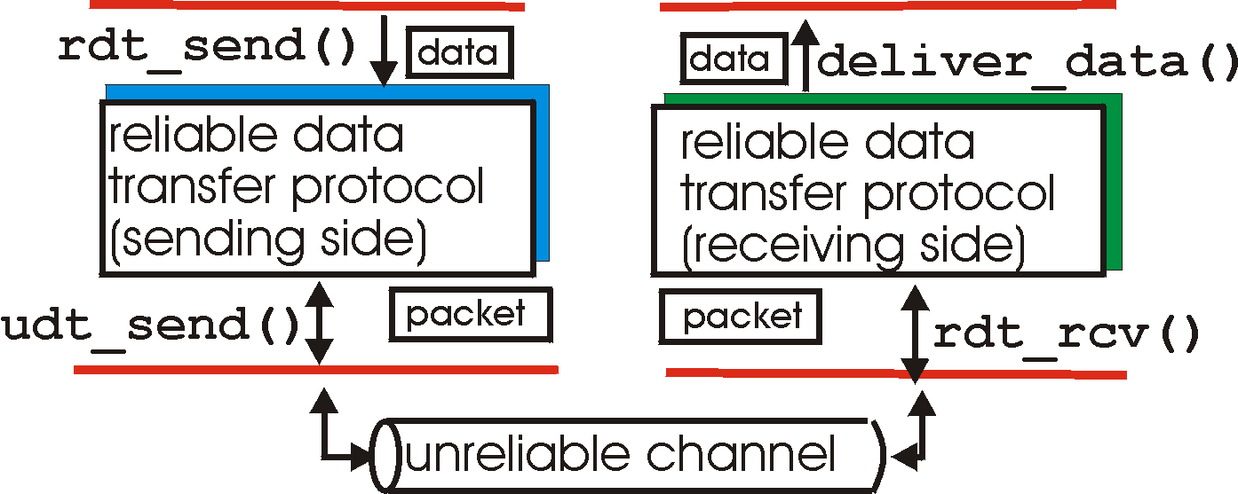
Reliable Data Transfer: Getting Started
rdt_send(): called from above, (e.g., by app.). Passed data to
deliver to receiver upper layer
deliver_data(): called by rdt to deliver data to upper
send
side
receive
side
udt_send(): called by rdt,
to transfer packet over
unreliable channel to receiver
rdt_rcv(): called when packet arrives on rcv-side of channel

Slide 18
Reliable Data Transfer: Getting Started
We’ll:
Incrementally develop sender, receiver sides of reliable data transfer protocol (rdt)
Consider only unidirectional data transfer
but control info will flow on both directions!
Use finite state machines (FSM) to specify sender, receiver
event causing state transition
actions taken on state transition
state: when in this “state” next state uniquely determined by next event
state 1
state 2
event
actions

Slide 19
Rdt1.0: Reliable Transfer over a Reliable Channel
Underlying channel perfectly reliable
no bit errors
no loss of packets
Separate FSMs for sender, receiver:
sender sends data into underlying channel
receiver read data from underlying channel
Wait for call from above
rdt_send(data)
Wait for call from below
rdt_rcv(packet)
extract (packet,data)
deliver_data(data)
packet = make_pkt(data)
udt_send(packet)
sender
Easy!
receiver

Slide 20
What if Taking a Message over Phone?
Message is clear?
Message is garbled?

Slide 21
What if Taking a Message over Phone?
Message is clear?
Ok
Message is garbled?
Ask to repeat
May not need whole message
In networks, called Automatic Repeat reQuest (ARQ)
Need error detection
Receiver feedback
Retransmission

Slide 22
Rdt2.0: Channel with Bit Errors (no Loss)
Underlying channel may flip bits in packet
Checksum to detect bit errors
The question: how to recover from errors:
acknowledgements (ACKs): receiver explicitly tells sender that pkt received OK
negative acknowledgements (NAKs): receiver explicitly tells sender that pkt had errors
Sender retransmits pkt on receipt of NAK
New mechanisms in rdt2.0 (beyond rdt1.0):
Error detection
Receiver feedback: control msgs (ACK,NAK) rcvr→sender

Slide 23
Rdt2.0: FSM Specification
rdt_send(data)
sndpkt = make_pkt(data, checksum)
udt_send(sndpkt)
receiver
rdt_rcv(rcvpkt) &&
isNAK(rcvpkt)
Wait for call from above
Wait for ACK or NAK
rdt_rcv(rcvpkt) &&
corrupt(rcvpkt)
udt_send(sndpkt)
udt_send(NAK)
rdt_rcv(rcvpkt) && isACK(rcvpkt)
Λ
Wait for call from below
sender
rdt_rcv(rcvpkt) &&
notcorrupt(rcvpkt)
extract(rcvpkt,data)
deliver_data(data)
udt_send(ACK)

Slide 24
Rdt2.0: Operation with No Errors
rdt_send(data)
snkpkt = make_pkt(data, checksum)
udt_send(sndpkt)
receiver
rdt_rcv(rcvpkt) &&
isNAK(rcvpkt)
Wait for call from above
Wait for ACK or NAK
rdt_rcv(rcvpkt) &&
corrupt(rcvpkt)
udt_send(sndpkt)
udt_send(NAK)
rdt_rcv(rcvpkt) && isACK(rcvpkt)
Wait for call from below
Λ
sender
rdt_rcv(rcvpkt) &&
notcorrupt(rcvpkt)
extract(rcvpkt,data)
deliver_data(data)
udt_send(ACK)

Slide 25
Rdt2.0: Error Scenario
rdt_send(data)
snkpkt = make_pkt(data, checksum)
udt_send(sndpkt)
receiver
rdt_rcv(rcvpkt) &&
isNAK(rcvpkt)
Wait for call from above
Wait for ACK or NAK
rdt_rcv(rcvpkt) &&
corrupt(rcvpkt)
udt_send(sndpkt)
udt_send(NAK)
rdt_rcv(rcvpkt) && isACK(rcvpkt)
Wait for call from below
Λ
sender
rdt_rcv(rcvpkt) &&
notcorrupt(rcvpkt)
stop and wait
Sender sends one packet,
then waits for receiver
response
extract(rcvpkt,data)
deliver_data(data)
udt_send(ACK)

Slide 26
Rdt2.0 Has a Fatal Flaw!
rdt_send(data)
sndpkt = make_pkt(data, checksum)
udt_send(sndpkt)
receiver
rdt_rcv(rcvpkt) &&
isNAK(rcvpkt)
Wait for call from above
Wait for ACK or NAK
rdt_rcv(rcvpkt) &&
corrupt(rcvpkt)
udt_send(sndpkt)
udt_send(NAK)
rdt_rcv(rcvpkt) && isACK(rcvpkt)
Λ
Wait for call from below
sender
rdt_rcv(rcvpkt) &&
notcorrupt(rcvpkt)
???
extract(rcvpkt,data)
deliver_data(data)
udt_send(ACK)

Slide 27
Rdt2.0 Has a Fatal Flaw!
What happens if ACK/NAK corrupted?
Sender doesn’t know what happened at receiver!
Can’t just retransmit: possible duplicate
How to handle duplicates?

Slide 28
Rdt2.0 Has a Fatal Flaw!
Handling duplicates:
Sender retransmits current pkt if ACK/NAK garbled
Sender adds sequence number to each pkt
Can use 1 bit (for now)
receiver discards (doesn’t deliver up) duplicate pkt
What happens if ACK/NAK corrupted?
Sender doesn’t know what happened at receiver!
Can’t just retransmit: possible duplicate

Slide 29
Rdt2.1: Sender, Handles Garbled ACK/NAKs
rdt_send(data)
sndpkt = make_pkt(0, data, checksum)
udt_send(sndpkt)
rdt_rcv(rcvpkt) &&
(corrupt(rcvpkt) ||
isNAK(rcvpkt) )
Wait for call 0 from above
Wait for ACK or NAK 0
udt_send(sndpkt)
rdt_rcv(rcvpkt)
&& notcorrupt(rcvpkt)
&& isACK(rcvpkt)
rdt_rcv(rcvpkt)
&& notcorrupt(rcvpkt)
&& isACK(rcvpkt)
Λ
Λ
Wait for ACK or NAK 1
Wait for
call 1 from above
rdt_rcv(rcvpkt) &&
( corrupt(rcvpkt) ||
isNAK(rcvpkt) )
rdt_send(data)
udt_send(sndpkt)
sndpkt = make_pkt(1, data, checksum)
udt_send(sndpkt)

Slide 30
Rdt2.1: Receiver, Handles Garbled ACK/NAKs
rdt_rcv(rcvpkt) && notcorrupt(rcvpkt)
&& has_seq0(rcvpkt)
extract(rcvpkt,data)
deliver_data(data)
sndpkt = make_pkt(ACK, chksum)
udt_send(sndpkt)
rdt_rcv(rcvpkt) && corrupt(rcvpkt)
rdt_rcv(rcvpkt) && corrupt(rcvpkt)
sndpkt = make_pkt(NAK, chksum)
udt_send(sndpkt)
sndpkt = make_pkt(NAK, chksum)
udt_send(sndpkt)
Wait for
0 from below
Wait for
1 from below
rdt_rcv(rcvpkt) &&
not corrupt(rcvpkt) &&
has_seq1(rcvpkt)
rdt_rcv(rcvpkt) &&
not corrupt(rcvpkt) &&
has_seq0(rcvpkt)
sndpkt = make_pkt(ACK, chksum)
udt_send(sndpkt)
sndpkt = make_pkt(ACK, chksum)
udt_send(sndpkt)
rdt_rcv(rcvpkt) && notcorrupt(rcvpkt)
&& has_seq1(rcvpkt)
extract(rcvpkt,data)
deliver_data(data)
sndpkt = make_pkt(ACK, chksum)
udt_send(sndpkt)

Slide 31
Rdt2.1: Discussion
Sender:
seq # added to pkt
two seq. #’s (0,1) will suffice
must check if received ACK/NAK corrupted
twice as many states
state must “remember” whether “current” pkt has 0 or 1 seq. #
Receiver:
must check if received packet is duplicate
state indicates whether 0 or 1 is expected pkt seq #
note: receiver can not know if its last ACK/NAK received OK at sender

Slide 32
Rdt2.2: a NAK-free Protocol
Reduce type of response → ACK only
Same functionality as rdt2.1, using ACKs only
Instead of NAK, receiver sends ACK for last pkt received OK
receiver must explicitly include seq # of pkt being ACKed
Duplicate ACK at sender results in same action as NAK: retransmit current pkt

Slide 33
Rdt2.2: Sender & Receiver Fragments
rdt_send(data)
sndpkt = make_pkt(0, data, checksum)
udt_send(sndpkt)
rdt_rcv(rcvpkt) &&
( corrupt(rcvpkt) ||
isACK(rcvpkt,1) )
Wait for call 0 from above
Wait for ACK 0
udt_send(sndpkt)
sender FSM
fragment
rdt_rcv(rcvpkt)
&& notcorrupt(rcvpkt)
&& isACK(rcvpkt,0)
rdt_rcv(rcvpkt) &&
(corrupt(rcvpkt) ||
has_seq1(rcvpkt))
Λ
Wait for
0 from below
receiver FSM
fragment
udt_send(sndpkt)
rdt_rcv(rcvpkt) && notcorrupt(rcvpkt)
&& has_seq1(rcvpkt)
extract(rcvpkt,data)
deliver_data(data)
sndpkt = make_pkt(ACK1, chksum)
udt_send(sndpkt)

Slide 34
Rdt3.0: Channels with Errors and Loss
New assumption: underlying channel can also lose packets (data or ACKs)
checksum, seq. #, ACKs, retransmissions will be of help, but not enough
How to determine if a packet is lost?

Slide 35
Rdt3.0: Channels with Errors and Loss
Approach: sender waits “reasonable” amount of time for ACK
Retransmits if no ACK received in this time
If pkt (or ACK) just delayed (not lost):
Retransmission will be duplicate, but use of seq. #’s already handles this
Receiver must specify seq # of pkt being ACKed
Requires countdown timer
New assumption: underlying channel can also lose packets (data or ACKs)
checksum, seq. #, ACKs, retransmissions will be of help, but not enough

Slide 36
Rdt3.0 Sender
rdt_send(data)
rdt_rcv(rcvpkt) &&
( corrupt(rcvpkt) ||
isACK(rcvpkt,1) )
sndpkt = make_pkt(0, data, checksum)
udt_send(sndpkt)
start_timer
rdt_rcv(rcvpkt)
Λ
Λ
Wait for
call 0from above
Wait for ACK0
timeout
udt_send(sndpkt)
start_timer
rdt_rcv(rcvpkt)
&& notcorrupt(rcvpkt)
&& isACK(rcvpkt,1)
rdt_rcv(rcvpkt)
&& notcorrupt(rcvpkt)
&& isACK(rcvpkt,0)
stop_timer
stop_timer
Wait for ACK1
Wait for
call 1 from above
timeout
udt_send(sndpkt)
start_timer
rdt_rcv(rcvpkt)
rdt_send(data)
Λ
rdt_rcv(rcvpkt) &&
( corrupt(rcvpkt) ||
isACK(rcvpkt,0) )
sndpkt = make_pkt(1, data, checksum)
udt_send(sndpkt)
start_timer
Λ

Slide 37
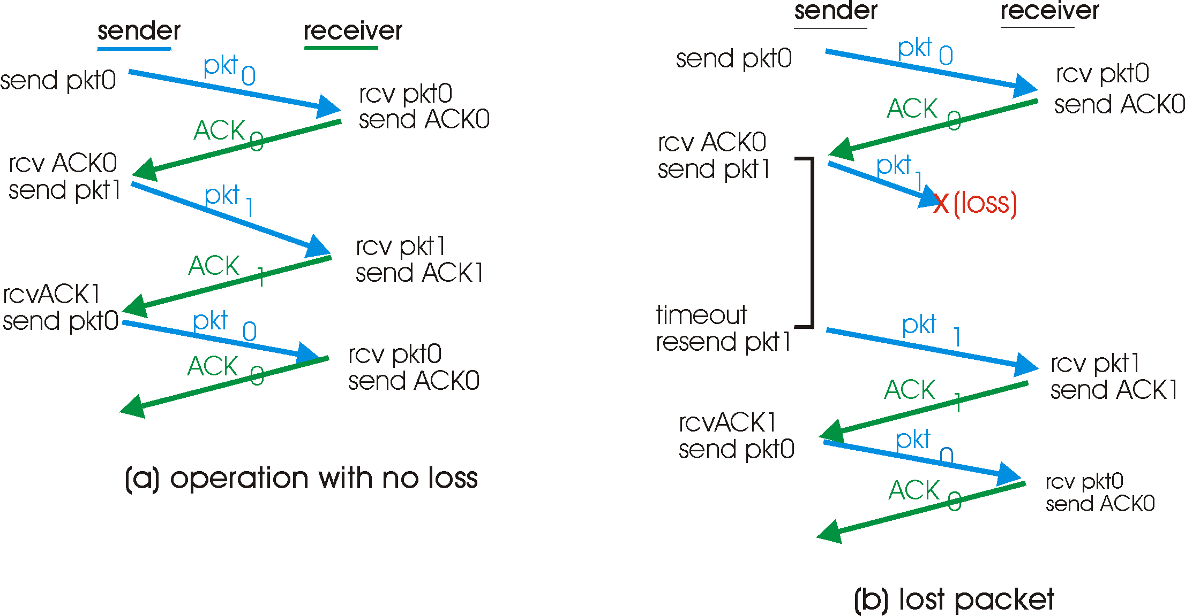
Rdt3.0 in Action

Slide 38
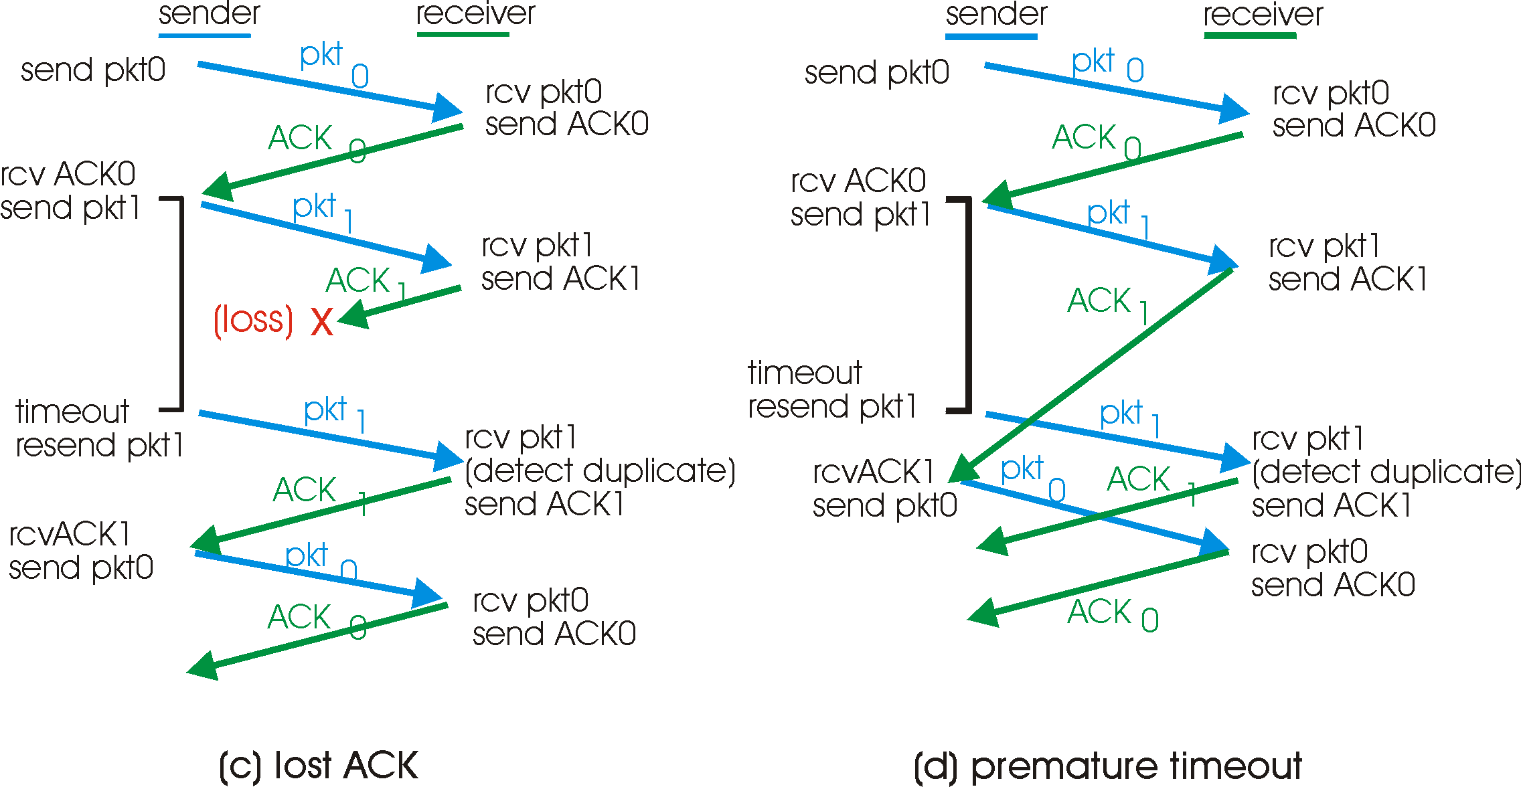
Rdt3.0 in Action

Slide 39
Performance of Rdt3.0
Rdt3.0 works, but performance stinks…
ex: 1 Gbps link, 15 ms prop. delay, 8000 bit packet:
U _{sender}: utilization – fraction of time sender busy sending
1KB pkt every 30 msec -> 33kB/sec throughput over 1 Gbps link
Network protocol limits use of physical resources!
(Picture next slide)

Slide 40
Rdt3.0: Stop-and-Wait Operation
sender
receiver
first packet bit transmitted, t = 0
last packet bit transmitted, t = L / R
first packet bit arrives
RTT
last packet bit arrives, send ACK
ACK arrives, send next
packet, t = RTT + L / R

Slide 41
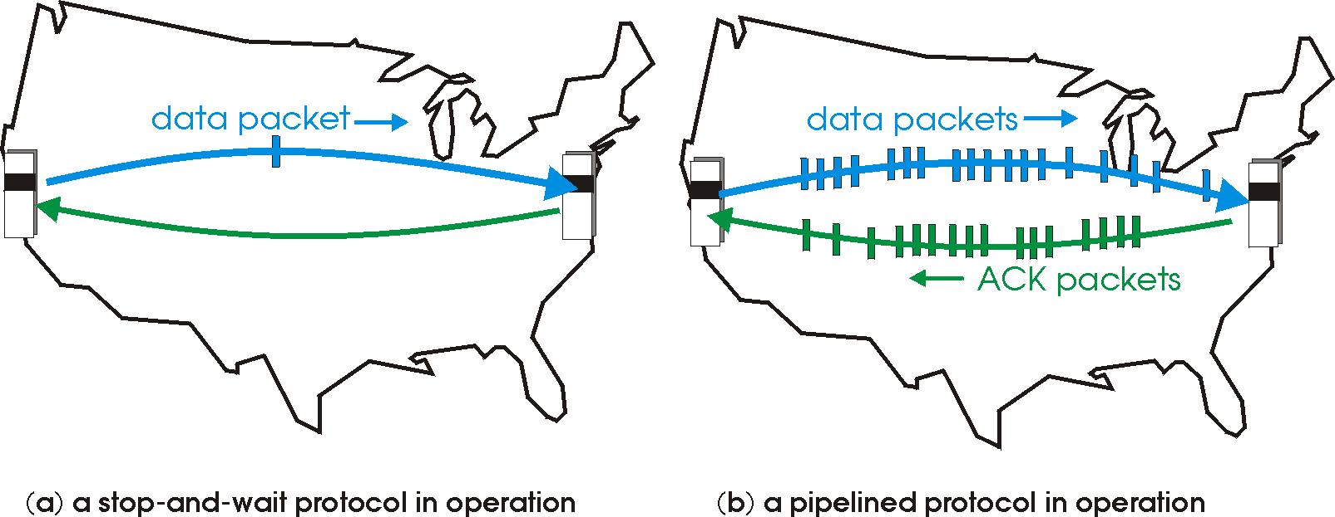
Pipelined Protocols
Pipelining: sender allows multiple, “in-flight”, yet-to-be-acknowledged pkts
Range of sequence numbers must be increased
Need buffering at sender and/or receiver

Slide 42
Pipelining: Increased Utilization
sender
receiver
first packet bit transmitted, t = 0
last bit transmitted, t = L / R
first packet bit arrives
RTT
last packet bit arrives, send ACK
last bit of 2nd packet arrives, send ACK
last bit of 3rd packet arrives, send ACK
ACK arrives, send next
packet, t = RTT + L / R
Increase utilization
by a factor of 3!
Two generic forms of pipelined protocols: go-Back-N, selective repeat

Slide 43
Pipelining Protocols
Go-back-N: overview
sender: up to N unACKed pkts in pipeline
receiver: only sends cumulative ACKs
doesn’t ACK pkt if there’s a gap
sender: has timer for oldest unACKed pkt
if timer expires: retransmit all unACKed packets
Selective Repeat: overview
sender: up to N unACKed packets in pipeline
receiver: ACKs individual pkts
sender: maintains timer for each unACKed pkt
if timer expires: retransmit only unACKed packet

Slide 44
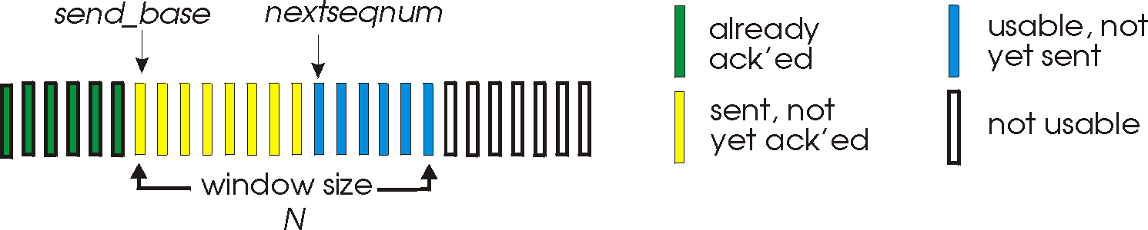
Go-Back-N
Sender:
k-bit seq # in pkt header
“window” of up to N, consecutive unACKed pkts allowed
ACK(n): ACKs all pkts up to, including seq # n - “cumulative ACK”
may receive duplicate ACKs (see receiver)
Timer for each in-flight pkt
Timeout(n): retransmit pkt n and all higher seq # pkts in window

Slide 45
GBN: Sender Extended FSM
rdt_send(data)
if (nextseqnum < base+N) {
sndpkt[nextseqnum] = make_pkt(nextseqnum,data,chksum)
udt_send(sndpkt[nextseqnum])
if (base == nextseqnum)
start_timer
nextseqnum++
}
else
refuse_data(data)
Λ
base=1
nextseqnum=1
timeout
Wait
start_timer
udt_send(sndpkt[base])
udt_send(sndpkt[base+1])
…
udt_send(sndpkt[nextseqnum-1])
rdt_rcv(rcvpkt)
&& corrupt(rcvpkt)
rdt_rcv(rcvpkt) &&
notcorrupt(rcvpkt)
base = getacknum(rcvpkt)+1
If (base == nextseqnum)
stop_timer
else
start_timer

Slide 46
GBN: Receiver Extended FSM
default
udt_send(sndpkt)
rdt_rcv(rcvpkt)
&& notcurrupt(rcvpkt)
&& hasseqnum(rcvpkt,expectedseqnum)
Λ
Wait
extract(rcvpkt,data)
deliver_data(data)
sndpkt = make_pkt(expectedseqnum,ACK,chksum)
udt_send(sndpkt)
expectedseqnum++
expectedseqnum=1
sndpkt =
make_pkt(expectedseqnum,ACK,chksum)
ACK-only: always send ACK for correctly-received pkt with highest in-order seq #
may generate duplicate ACKs
need only remember expectedseqnum
out-of-order pkt:
discard (don’t buffer) -> no receiver buffering!
Re-ACK pkt with highest in-order seq #

Slide 47
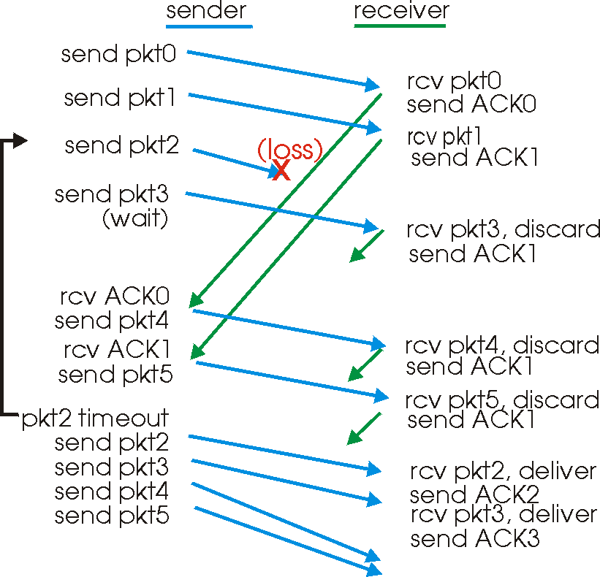
GBN in action

Slide 48
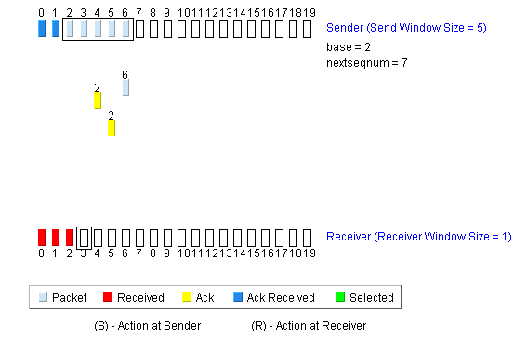
GBN Applet!
http://media.pearsoncmg.com/aw/aw_kurose_network_4/applets/go-back-n/index.html

Slide 49
Selective Repeat
Receiver individually acknowledges all correctly received pkts
Buffers pkts, as needed, for eventual in-order delivery to upper layer
Sender only resends pkts for which ACK not received
Sender timer for each unACKed pkt
Sender window
N consecutive seq #’s
Again limits seq #s of sent, unACKed pkts

Slide 50
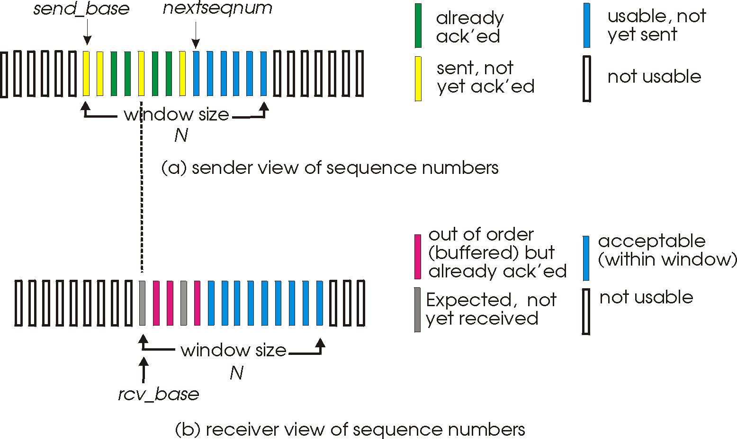
Selective Repeat: sender, receiver windows

Slide 51
Selective Repeat
sender
receiver
pkt n in [rcvbase, rcvbase+N-1]
send ACK(n)
out-of-order: buffer
in-order: deliver (also deliver buffered, in-order pkts), advance window to next not-yet-received pkt
pkt n in [rcvbase-N,rcvbase-1]
ACK(n)
otherwise:
ignore
data from above :
if next available seq # in window, send pkt
timeout(n):
resend pkt n, restart timer
ACK(n) in [sendbase,sendbase+N]:
mark pkt n as received
if n smallest unACKed pkt, advance window base to next unACKed seq #

Slide 52
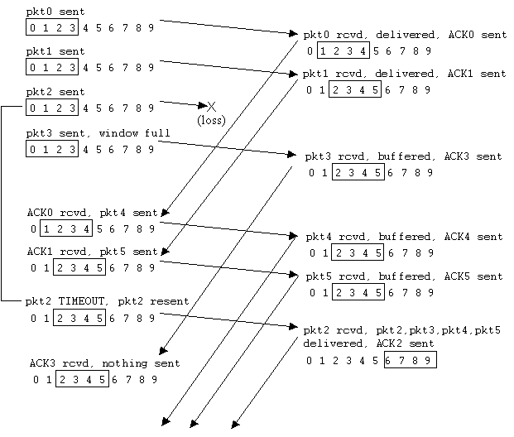
Selective Repeat in Action

Slide 53
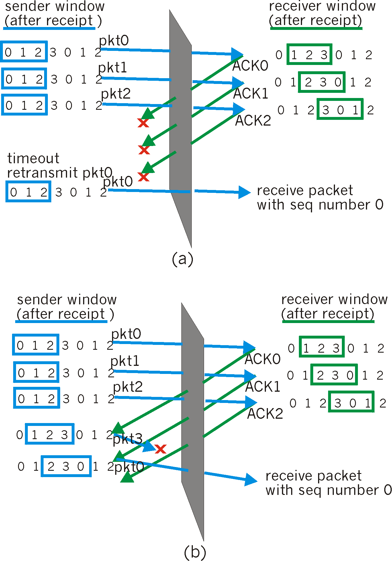
Selective Repeat: Dilemma
Example:
seq #’s: 0, 1, 2, 3
window size=3
receiver sees no difference in two scenarios!
incorrectly passes duplicate data as new in (a)
Q: what relationship between seq # size and window size?

Slide 54
SR Applet!
http://media.pearsoncmg.com/aw/aw_kurose_network_4/applets/SR/index.html

Slide 55
Chapter 3 outline
3.5 Connection-oriented transport: TCP
segment structure
reliable data transfer
flow control
connection management
3.6 Principles of congestion control
3.7 TCP congestion control
3.1 Transport-layer services
3.2 Multiplexing and demultiplexing
3.3 Connectionless transport: UDP
3.4 Principles of reliable data transfer

Slide 56
TCP: Overview RFCs: 793, 1122, 1323, 2018, 2581
point-to-point:
one sender, one receiver
reliable, in-order byte steam:
no “message boundaries”
pipelined:
TCP congestion and flow control set window size
send & receive buffers
full duplex data:
bi-directional data flow in same connection
MSS: maximum segment size
connection-oriented:
handshaking (exchange of control msgs) init’s sender, receiver state before data exchange
flow controlled:
sender will not overwhelm receiver

Slide 57
TCP Segment Structure
32 bits
URG: urgent data
(generally not used)
counting
by bytes
of data
(not segments!)
source port #
dest port #
sequence number
ACK: ACK #
valid
acknowledgement number
head
len
not
used
U
Receive window
A
P
R
S
PSH: push data now
(generally not used)
F
# bytes
rcvr willing
to accept
checksum
Urg data pointer
RST, SYN, FIN:
connection estab
(setup, teardown
commands)
Options (variable length)
application
data
(variable length)
Internet
checksum
(as in UDP)

Slide 58
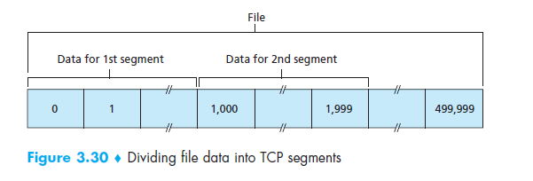

Slide 59
TCP Seq. #’s and ACKs
Seq. #’s:
byte stream “number” of first byte in segment’s data
ACKs:
seq # of next byte expected from other side
cumulative ACK
Q: how receiver handles out-of-order segments
A: TCP spec doesn’t say → up to implementer
Host A
Host B
User
types
‘C’
Seq=42, ACK=79, data = ‘C’
host ACKs
receipt of
‘C’, echoes
back ‘C’
Seq=79, ACK=43, data = ‘C’
host ACKs
receipt
of echoed
‘C’
Seq=43, ACK=80
simple telnet scenario
time

Slide 60
TCP Round Trip Time and Timeout
Q: how to set TCP timeout value?

Slide 61
TCP Round Trip Time and Timeout
Q: how to set TCP timeout value?
Longer than RTT
but RTT varies
Too short? premature timeout
unnecessary retransmissions
Too long? slow reaction to segment loss
Q: how to estimate RTT?

Slide 62
TCP Round Trip Time and Timeout
Q: how to set TCP timeout value?
Longer than RTT
but RTT varies
Too short? premature timeout
unnecessary retransmissions
Too long? slow reaction to segment loss
Q: how to estimate RTT?
SampleRTT: measured time from segment transmission until ACK receipt
ignore retransmissions
SampleRTT will vary, want estimated RTT “smoother”
average several recent measurements, not just current SampleRTT

Slide 63
TCP Round Trip Time and Timeout
EstimatedRTT = (1- α)*EstimatedRTT + α*SampleRTT
Exponential weighted moving average
influence of past sample decreases exponentially fast
typical value: α = 1/8th (or 0.125)

Slide 64
Example Round Trip Time Estimation

Slide 65
TCP Round Trip Time and Timeout
Setting the timeout
EstimtedRTT plus “safety margin”
large variation in EstimatedRTT -> larger safety margin
First estimate of how much SampleRTT deviates from EstimatedRTT:
DevRTT = (1-β)*DevRTT +
β*|SampleRTT-EstimatedRTT|
(typically, β = 0.25)
Then set timeout interval:
TimeoutInterval = EstimatedRTT + 4*DevRTT

Slide 66
Chapter 3 outline
3.5 Connection-oriented transport: TCP
segment structure
reliable data transfer
flow control
connection management
3.6 Principles of congestion control
3.7 TCP congestion control
3.1 Transport-layer services
3.2 Multiplexing and demultiplexing
3.3 Connectionless transport: UDP
3.4 Principles of reliable data transfer

Slide 67
TCP reliable data transfer
TCP creates rdt service on top of IP’s unreliable service
Pipelined segments
Cumulative ACKs
TCP uses single retransmission timer
Retransmissions are triggered by:
Timeout events
Duplicate ACKs
Initially consider simplified TCP sender:
Ignore duplicate ACKs
Ignore flow control, congestion control

Slide 68
TCP Sender Events:
Data rcvd from app:
Create segment with seq #
seq # is byte-stream number of first data byte in segment
Start timer if not already running (think of timer as for oldest unACKed segment)
Expiration interval: TimeOutInterval
Timeout:
retransmit segment that caused timeout
restart timer
ACK rcvd:
If acknowledges previously unACKed segments
update what is known to be ACKed
start timer if there are outstanding segments

Slide 69
TCP Sender (simplified)
NextSeqNum = InitialSeqNum
SendBase = InitialSeqNum
loop (forever) {
switch(event)
event: data received from application above
create TCP segment w/seq # NextSeqNum
if (timer currently not running)
start timer
pass segment to IP
NextSeqNum = NextSeqNum + length(data)
event: timer timeout
retransmit not-yet-acked segment with
smallest sequence number
start timer
event: ACK received, with ACK field value of y
if (y > SendBase) {
SendBase = y
if (there are not-yet-acked segments)
start timer
}
} /* end of loop forever */
Comment:
SendBase-1: last
cumulatively ACKed byte
Example:
SendBase-1 = 71; y= 73, so the rcvr wants 73+ ; y > SendBase, so that new data is ACKed

Slide 70
TCP: Retransmission Scenarios
Host A
Host B
Host A
Host B
Seq=92, 8 bytes data
Seq=92, 8 bytes data
Seq=100, 20 bytes data
timeout
ACK=100
Seq=92 timeout
X
ACK=100
loss
ACK=120
Seq=92, 8 bytes data
Sendbase
= 100
Seq=92, 8 bytes data
SendBase
= 120
Seq=92 timeout
ACK=120
ACK=100
SendBase
= 100
SendBase
= 120
premature timeout
time
time
lost ACK scenario

Slide 71
TCP Retransmission Scenarios (more)
Host A
Host B
Seq=92, 8 bytes data
ACK=100
timeout
Seq=100, 20 bytes data
X
loss
SendBase
= 120
ACK=120
time
Cumulative ACK scenario

Slide 72
TCP ACK generation [RFC 1122, RFC 2581]
Event at Receiver
Arrival of in-order segment with
expected seq #. All data up to
expected seq # already ACKed
Arrival of in-order segment with
expected seq #. One other
segment has ACK pending
Arrival of out-of-order segment
higher-than-expect seq. # .
Gap detected
Arrival of segment that
partially or completely fills gap
TCP Receiver action
Delayed ACK. Wait up to 500ms
for next segment. If no next segment,
send ACK
Immediately send single cumulative
ACK, ACKing both in-order segments
Immediately send duplicate ACK,
indicating seq. # of next expected byte
Immediate send ACK, provided that
segment starts at lower end of gap

Slide 73
Fast Retransmit
Time-out period often relatively long:
Long delay before resending lost packet
Detect lost segments via duplicate ACKs
Sender often sends many segments back-to-back
If segment lost, there will likely be many duplicate ACKs for that segment
If sender receives 3 ACKs for same data, it assumes that segment after ACKed data was lost:
fast retransmit: resend segment before timer expires

Slide 74
Fast Retransmit
Host A
Host B
seq # x1
seq # x2
seq # x3
X
ACK x1
seq # x4
seq # x5
ACK x1
ACK x1
ACK x1
triple
duplicate
ACKs
resend seq X2
timeout
time

Slide 75
Chapter 3 outline
3.5 Connection-oriented transport: TCP
segment structure
reliable data transfer
flow control
connection management
3.6 Principles of congestion control
3.7 TCP congestion control
3.1 Transport-layer services
3.2 Multiplexing and demultiplexing
3.3 Connectionless transport: UDP
3.4 Principles of reliable data transfer

Slide 76
TCP Flow Control
flow control
sender won’t overflow
receiver’s buffer by
transmitting too much,
too fast
Receive side of TCP connection has a receive buffer:
(currently)
unused buffer
space
speed-matching service: matching send rate to receiving application’s drain rate
IP
datagrams
TCP data
(in buffer)
application
process
App process may be slow at reading from buffer

Slide 77
TCP Flow Control: How it Works
(currently)
unused buffer
space
Receiver: advertises unused buffer space by including rwnd value in segment header
sender: limits # of unACKed bytes to rwnd
guarantees receiver’s buffer doesn’t overflow
IP
datagrams
TCP data
(in buffer)
application
process
rwnd
RcvBuffer
(suppose TCP receiver discards out-of-order segments)
unused buffer space:
= rwnd
= RcvBuffer-[LastByteRcvd - LastByteRead]

Slide 78
Chapter 3 outline
3.5 Connection-oriented transport: TCP
segment structure
reliable data transfer
flow control
connection management
3.6 Principles of congestion control
3.7 TCP congestion control
3.1 Transport-layer services
3.2 Multiplexing and demultiplexing
3.3 Connectionless transport: UDP
3.4 Principles of reliable data transfer

Slide 79
TCP Connection Management
Recall: TCP sender, receiver establish “connection” before exchanging data segments
initialize TCP variables:
seq. #s
buffers, flow control info (e.g. RcvWindow)
client: connection initiator
Socket clientSocket = new Socket(“hostname”, port#);
server: contacted by client
Socket connectionSocket = welcomeSocket.accept();
Three way handshake:
Step 1: client host sends TCP SYN segment to server
specifies initial seq #
no data
Step 2: server host receives SYN, replies with SYNACK segment
server allocates buffers
specifies server initial seq. #
Step 3: client receives SYNACK, replies with ACK segment, which may contain data

Slide 80
TCP Connection Management (cont.)
Closing a connection:
client closes socket: clientSocket.close();
Step 1: client end system sends TCP FIN control segment to server
Step 2: server receives FIN, replies with ACK. Closes connection, sends FIN.
client
server
close
FIN
ACK
close
FIN
ACK
timed wait
closed

Slide 81
TCP Connection Management (cont.)
Step 3: client receives FIN, replies with ACK.
Enters “timed wait” - will respond with ACK to received FINs
Step 4: server, receives ACK. Connection closed.
client
server
closing
FIN
ACK
closing
FIN
ACK
timed wait
closed
closed

Slide 82
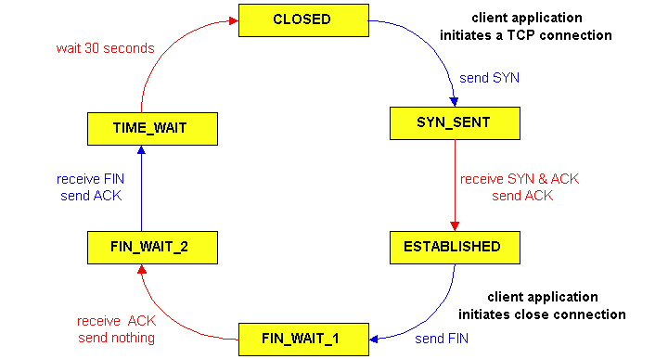
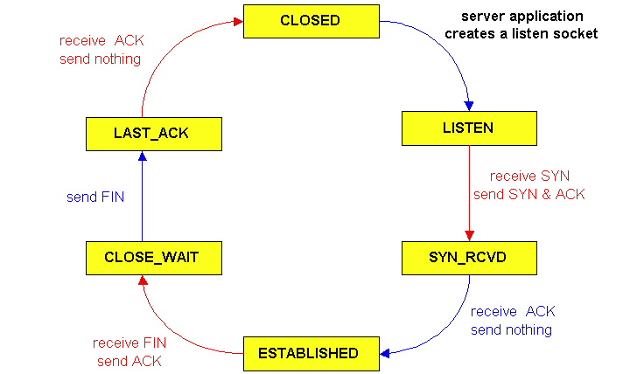
TCP Connection Management (cont.)
TCP server
lifecycle
TCP client
lifecycle

Slide 83
Chapter 3 outline
3.5 Connection-oriented transport: TCP
segment structure
reliable data transfer
flow control
connection management
3.6 Principles of congestion control
3.7 TCP congestion control
3.1 Transport-layer services
3.2 Multiplexing and demultiplexing
3.3 Connectionless transport: UDP
3.4 Principles of reliable data transfer

Slide 84
Principles of Congestion Control
Congestion:
Informally: “too many sources sending too much data too fast for network to handle”
Different from flow control!
Manifestations:
Lost packets (buffer overflow at routers)
Long delays (queueing in router buffers)
A “top-10” problem!

Slide 85
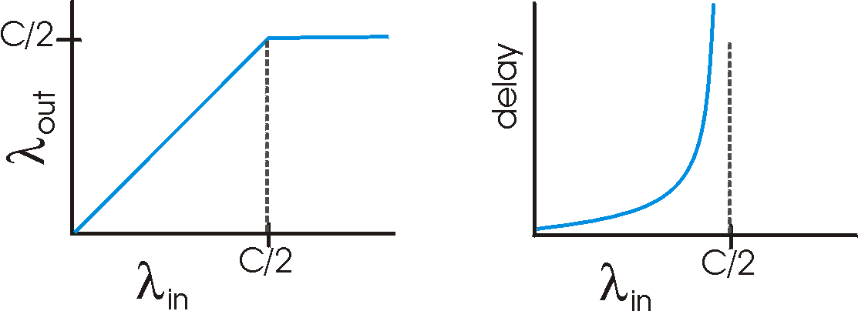
Causes/costs of Congestion: Scenario 1
Two senders, two receivers
One router, infinite buffers
No retransmission
Host A
λ_{in} : original data
λ_{out}
Host B
unlimited shared output link buffers
Large delays when congested
Maximum achievable throughput

Slide 86
Causes/costs of Congestion: Scenario 2
One router, finite buffers
Sender retransmission of lost packet
Host A
λ_{in} : original data
λ_{out}
λ'_{in} : original data, plus retransmitted data
Host B
finite shared output link buffers

Slide 87
Causes/costs of congestion: Scenario 2
λ
λ
Always: (goodput)
“Perfect” retransmission only when loss:
Retransmission of delayed (not lost) packet makes larger (than perfect case) for same
=
in
out
λ
>
λ
in
out
λ
in
λ
out
R/2
R/2
R/2
R/3
λ_{out}
λ_{out}
λ_{out}
R/4
λ_{in}
R/2
λ_{in}
R/2
λ_{in}
R/2
a.
b.
c.
“Costs” of congestion:
More work (retrans) for given “goodput”
unneeded retransmissions: link carries multiple copies of pkt

Slide 88
Causes/costs of Congestion: Scenario 3
λ
Four senders
Multihop paths
Timeout/retransmit
Q: what happens as and increase ?
λ
in
in
Host A
λ_{in} : original data
λ_{out}
λ'_{in} : original data, plus retransmitted data
finite shared output link buffers
Host B

Slide 89
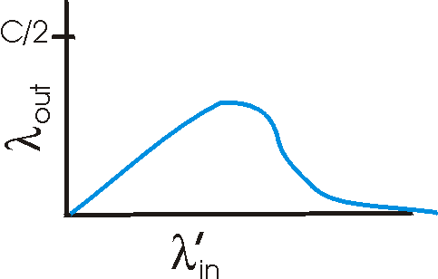
Causes/costs of Congestion: Scenario 3
Host A
λ_{out}
Host B
Another “cost” of congestion:
When packet dropped, any “upstream transmission capacity used for that packet was wasted!

Slide 90
Approaches towards congestion control
Broadly:
End-end congestion control:
No explicit feedback from network
Congestion inferred from end-system observed loss, delay
Approach taken by TCP
Network-assisted congestion control:
Routers provide feedback to end systems
Single bit indicating congestion (SNA, DECbit, TCP/IP ECN, ATM)
Explicit rate sender should send at

Slide 91
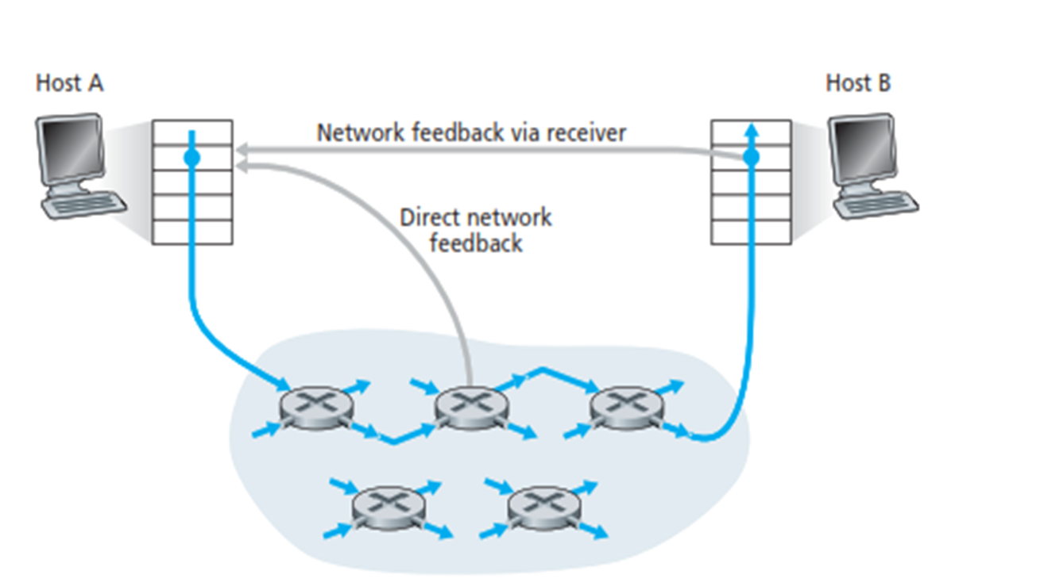
Network assisted congestion control

Slide 92
Chapter 3 outline
3.5 Connection-oriented transport: TCP
segment structure
reliable data transfer
flow control
connection management
3.6 Principles of congestion control
3.7 TCP congestion control
3.1 Transport-layer services
3.2 Multiplexing and demultiplexing
3.3 Connectionless transport: UDP
3.4 Principles of reliable data transfer

Slide 93
TCP Congestion Control:
Goal: TCP sender should transmit as fast as possible, but without congesting network
Q: how to find rate just below congestion level?
Decentralized: each TCP sender sets its own rate, based on implicit feedback:
ACK: segment received (a good thing!), network not congested, so increase sending rate
lost segment: assume loss due to congested network, so decrease sending rate

Slide 94
TCP Congestion Control: Bandwidth Probing
“Probing for bandwidth”: increase transmission rate on receipt of ACK, until eventually loss occurs, then decrease transmission rate
continue to increase on ACK, decrease on loss (since available bandwidth is changing, depending on other connections in network)
ACKs being received,
so increase rate
X
loss, so decrease rate
X
X
X
TCP’s
“sawtooth”
behavior
sending rate
X
time
Q: how fast to increase/decrease?
details to follow

Slide 95
TCP Congestion Control: details
sender limits rate by limiting number of unACKed bytes “in pipeline”:
cwnd: differs from rwnd (how, why?)
sender limited by min(cwnd,rwnd)
roughly,
cwnd is dynamic, function of perceived network congestion
LastByteSent-LastByteAcked ≤ cwnd
cwnd
bytes
cwnd
rate =
bytes/sec
RTT
RTT
ACK(s)

Slide 96
TCP Congestion Control: more details
segment loss event: reducing cwnd
timeout: no response from receiver
cut cwnd to 1
3 duplicate ACKs: at least some segments getting through (recall fast retransmit)
cut cwnd in half, less aggressively than on timeout
ACK received: increase cwnd
slowstart phase:
increase exponentially fast (despite name) at connection start, or following timeout
congestion avoidance:
increase linearly

Slide 97
TCP Slow Start
when connection begins, cwnd = 1 MSS
example: MSS = 500 bytes & RTT = 200 msec
initial rate = 20 kbps
available bandwidth may be >> MSS/RTT
desirable to quickly ramp up to respectable rate
increase rate exponentially until first loss event or when threshold reached
double cwnd every RTT
done by incrementing cwnd by 1 for every ACK received
Host A
Host B
one segment
RTT
two segments
four segments
time

Slide 98
Transitioning into/out of slowstart
ssthresh: cwnd threshold maintained by TCP
on loss event: set ssthresh to cwnd/2
remember (half of) TCP rate when congestion last occurred
when cwnd >= ssthresh: transition from slowstart to congestion avoidance phase
duplicate ACK
dupACKcount++
new ACK
cwnd = cwnd+MSS
dupACKcount = 0
transmit new segment(s),as allowed
Λ
cwnd = 1 MSS
ssthresh = 64 KB
dupACKcount = 0
cwnd > ssthresh
slow
start
Λ
congestion
avoidance
timeout
ssthresh = cwnd/2
cwnd = 1 MSS
dupACKcount = 0
retransmit missing segment
timeout
ssthresh = cwnd/2
cwnd = 1 MSS
dupACKcount = 0
retransmit missing segment

Slide 99
TCP: Congestion Avoidance
When cwnd > ssthresh grow cwnd linearly
increase cwnd by 1 MSS per RTT
approach possible congestion slower than in slowstart
implementation: cwnd = cwnd + MSS/cwnd for each ACK received
AIMD
ACKs: increase cwnd by 1 MSS per RTT: additive increase
loss: cut cwnd in half (non-timeout-detected loss ): multiplicative decrease
AIMD: Additive Increase
Multiplicative Decrease

Slide 100
TCP Congestion Control FSM: overview
slow
start
cwnd > ssthresh
congestion
avoidance
loss:
timeout
loss:
timeout
loss:
timeout
new ACK
loss:
3dupACK
fast
recovery
loss:
3dupACK

Slide 101
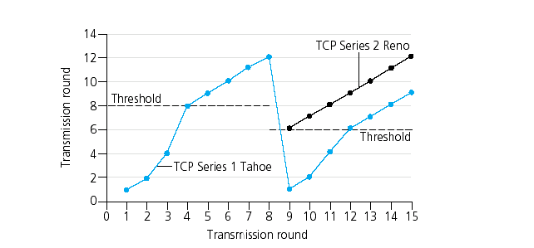
Popular “flavors” of TCP
TCP Reno
ssthresh
cwnd window size (in segments)
ssthresh
TCP Tahoe
Transmission round

Slide 102
Summary: TCP Congestion Control
when cwnd < ssthresh, sender in slow-start phase, window grows exponentially.
when cwnd >= ssthresh, sender is in congestion-avoidance phase, window grows linearly.
when triple duplicate ACK occurs, ssthresh set to cwnd/2, cwnd set to ~ ssthresh
when timeout occurs, ssthresh set to cwnd/2, cwnd set to 1 MSS.

Slide 103
TCP throughput
Q: what’s average throughout of TCP as function of window size, RTT?
ignoring slow start
Let W be window size when loss occurs.
when window is W, throughput is W/RTT
just after loss, window drops to W/2, throughput to W/2RTT.
average throughout: .75 W/RTT

Slide 104
TCP Futures: TCP over “long, fat pipes”
Example: 1500 byte segments, 100ms RTT, want 10 Gbps throughput
Requires window size W = 83,333 in-flight segments!
throughput in terms of loss rate:
➜ L = 2·10⁻¹⁰ Wow
New versions of TCP for high-speed

Slide 105
TCP Fairness
fairness goal: if K TCP sessions share same bottleneck link of bandwidth R, each should have average rate of R/K
TCP connection 1
TCP
connection 2
bottleneck
router
capacity R

Slide 106
Why is TCP fair?
Two competing sessions:
Additive increase gives slope of 1, as throughout increases
multiplicative decrease decreases throughput proportionally
R
equal bandwidth share
loss: decrease window by factor of 2
Connection 2 throughput
congestion avoidance: additive increase
loss: decrease window by factor of 2
congestion avoidance: additive increase
Connection 1 throughput
R

Slide 107
Fairness (more)
Fairness and UDP
Multimedia apps often do not use TCP
do not want rate throttled by congestion control
Instead use UDP:
pump audio/video at constant rate, tolerate packet loss
Fairness and Parallel TCP Connections
Nothing prevents app from opening parallel connections between 2 hosts.
Web browsers do this
Example: link of rate R supporting 9 connections;
new app asks for 1 TCP, gets rate R/10
new app asks for 11 TCPs, gets R/2 !

Slide 108
Chapter 3: Summary
Principles behind transport layer services:
multiplexing, demultiplexing
reliable data transfer
flow control
congestion control
Instantiation and implementation in the Internet
UDP
TCP
Next:
leaving the network “edge” (application, transport layers)
into the network “core”

